Slide 1


Internet & World Wide Web
How to Program
Copyright © Pearson, Inc. . All Rights Reserved.

Slide 2
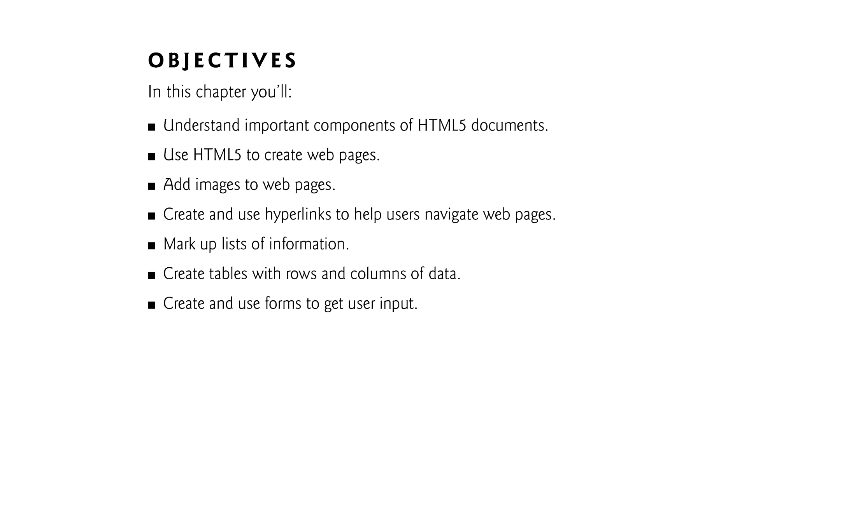

Slide 3

HTML5 (HyperText Markup Language 5)
  markup language that specifies the structure and content of documents that are displayed in web browsers
We introduce some basics, then cover more sophisticated HTML5 techniques such as:
  tables, which are particularly useful for structuring information from databases (i.e., software that stores structured sets of data)
  forms for collecting information from web-page visitors
  internal linking for easier page navigation
  meta elements for specifying information about a document

Slide 4

You can find PowerPoint content in the link:
https://www.w3schools.com/html/default.asp
From “HTML HOME” to “HTML Attributes”.
Copyright © Pearson, Inc. . All Rights Reserved.

Slide 5

HTML is the standard markup language for creating Web pages.
HTML describes the structure of a Web page.
HTML consists of a series of elements.
HTML is Not Case Sensitive.
HTML elements tell the browser how to display the content.

Slide 6

<!DOCTYPE html>
<html>
<head>
<title>Page Title</title>
</head>
<body>
<h1>My First Heading</h1>
<p>My first paragraph.</p>
</body>
</html>

Slide 7

The <!DOCTYPE html> declaration defines that this document is an HTML5 document
The <html> element is the root element of an HTML page
The <head> element contains meta information about the HTML page
The <title> element specifies a title for the HTML page (which is shown in the browser's title bar or in the page's tab)
The <body> element defines the document's body, and is a container for all the visible contents, such as headings, paragraphs, images, hyperlinks, tables, lists, etc.
The <h1> element defines a large heading
The <p> element defines a paragraph

Slide 8

An HTML element is defined by a start tag, some content, and an end tag:
<tagname> Content goes here... </tagname>
The HTML element is everything from the start tag to the end tag:
<h1>My First Heading</h1>
<p>My first paragraph.</p>

Slide 9

The purpose of a web browser (Chrome, Edge, Firefox, Safari) is to read HTML documents and display them correctly.
A browser does not display the HTML tags, but uses them to determine how to display the document

Slide 10

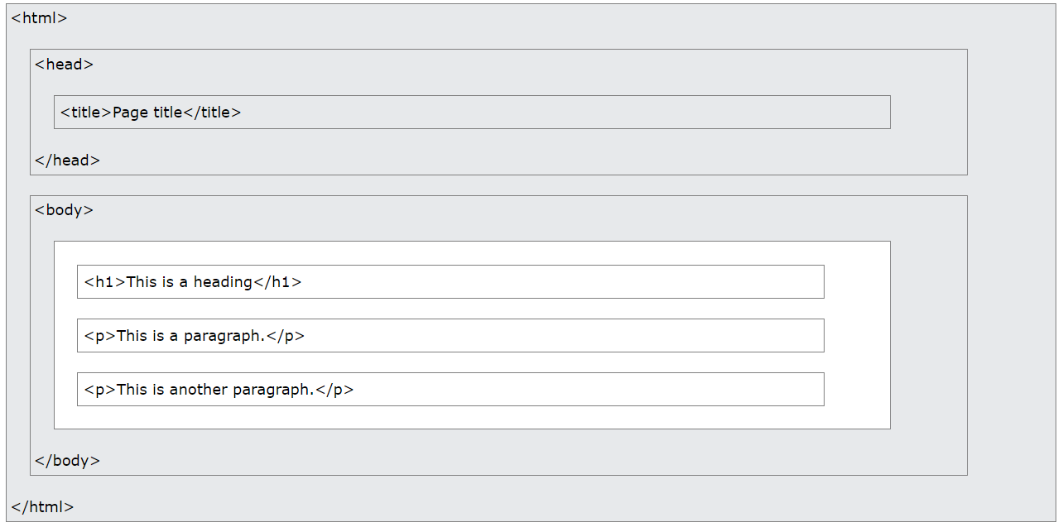

Slide 11

A simple text editor is all you need to learn HTML.
For learning HTML we recommend a simple text editor like Notepad (PC) or TextEdit (Mac).
W3Schools Online Editor: https://www.w3schools.com/html/tryit.asp?filename=tryhtml_editors

Slide 12

Write or copy the following HTML code into Notepad:
<!DOCTYPE html>
<html>
<body>
<h1>My First Heading</h1>
<p>My first paragraph.</p>
</body>
</html>
Save the file on your computer with extension “html” for example “index.html”.

Slide 13

All HTML documents must start with a document type declaration: <!DOCTYPE html>.
The HTML document itself begins with <html> and end with </html>.
The visible part of the HTML document is between <body> and </body>.
HTML Headings:
HTML headings are defined with the <h1> to <h6> tags.
<h1> defines the most important heading. <h6> defines the least important heading

Slide 14

HTML Paragraphs
HTML paragraphs are defined with the <p> tag:
<p>This is a paragraph.</p>
<p>This is another paragraph.</p>
HTML Links
HTML links are defined with the <a> tag
<a href="https://www.w3schools.com">This is a link</a>

Slide 15

HTML attributes provide additional information about HTML elements.
Attributes provide additional information about elements.
Attributes are always specified in the start tag.
Attributes usually come in pairs : name="value“.
The href Attribute
The <a> tag defines a hyperlink. The href attribute specifies the URL of the page the link goes to:
  <a href="https://www.w3schools.com">Visit W3Schools</a>

Slide 16
The src Attribute
The <img> tag is used to embed an image in an HTML page. The src attribute specifies the path to the image to be displayed.
  <Img src="img_girl.jpg">
The width and height Attributes
The <img> tag should also contain the width and height attributes
  <img src="img_girl.jpg" width="500" height="600“>
The alt Attribute
The required alt attribute for the <img> tag specifies an alternate text for an image, if the image for some reason cannot be displayed.
<img src="img_girl.jpg" alt="Girl with a jacket">
:

Slide 17
The style Attribute
The style attribute is used to add styles to an element, such as color, font, size, and more .
  <p style="color:red;">This is a red paragraph.</p>
The lang Attribute
To declare the language of the Web page. This is meant to assist search engines and browsers.
The title Attribute
The title attribute defines some extra information about an element.

Slide 18
The value of the title attribute will be displayed as a tooltip when you mouse over the element:
  <p title="I'm a tooltip">This is a paragraph.</p>
Advices for attributes
  Always Use Lowercase Attributes
  Always Quote Attribute Values
  Good: <a href="https://www.w3schools.com/html/">Visit our HTML tutorial</a>
  Bad: <a href=https://www.w3schools.com/html/>Visit our HTML tutorial</a>

Slide 19
Single or Double Quotes?
Double quotes around attribute values are the most common in HTML, but single quotes can also be used.
  <p title='John "ShotGun" Nelson’>
  <p title="John 'ShotGun' Nelson">

Slide 20

All HTML elements can have attributes
The href attribute of <a> specifies the URL of the page the link goes to
The src attribute of <img> specifies the path to the image to be displayed
The width and height attributes of <img> provide size information for images
The alt attribute of <img> provides an alternate text for an image
The style attribute is used to add styles to an element, such as color, font, size, and more
The lang attribute of the <html> tag declares the language of the Web page
The title attribute defines some extra information about an element

